Slide 1
軟體工程設計 W8
許庭瑋、陳君翰、洪世彬、劉玠均、楊昕叡、林俊佑
2023/11/09

Slide 2
Homework

Slide 3
Dependency Injection
target: reduce the coupling between different components in a software system and makes it easier to replace or change dependencies without affecting the class that uses them
core: dependencies required by a class or component are provided from external sources, rather than the class creating them itself
term “client”: class or component who needs dependencies for other services
Notes:
without affecting the class that uses them

Slide 4
3 types of Dependency Injection
constructor injection
method injection (interface injection)
property injection (setter injection)
Notes:
no field injection

Slide 5
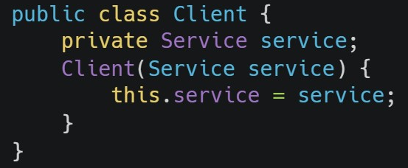
constructor injection
Dependencies of a client are passed as arguments and injected through its constructor.
example:

Slide 6
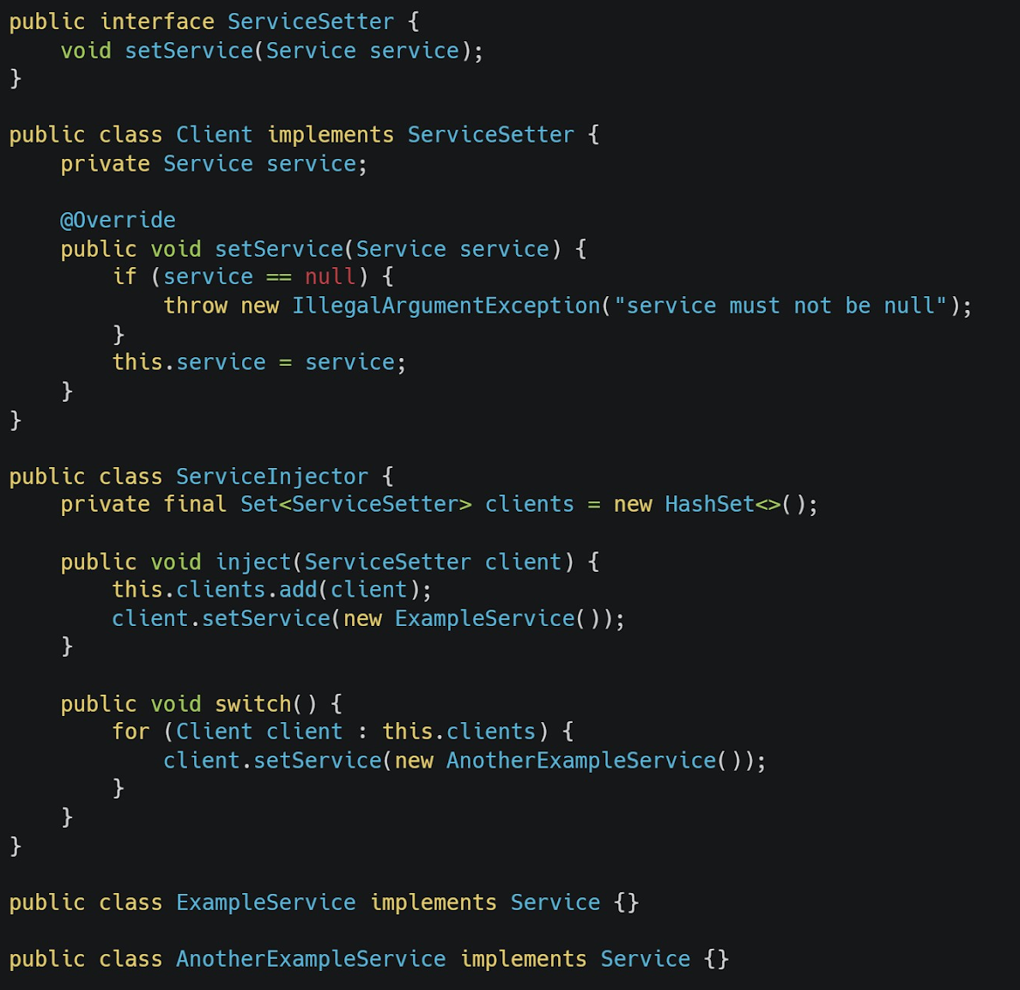
method injection
A method in dependency class can be called with different arguments.
In the example, ServiceInjector call Client.setService() with different arguments to inject different dependencies.
Notes:
interface injection

Slide 7
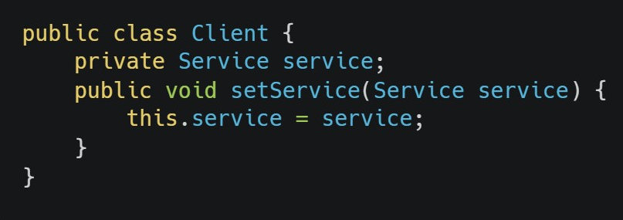
property injection
Clients provide methods to allow users to set or change the value of dependencies, which are client’s attributes.
example:

Slide 8
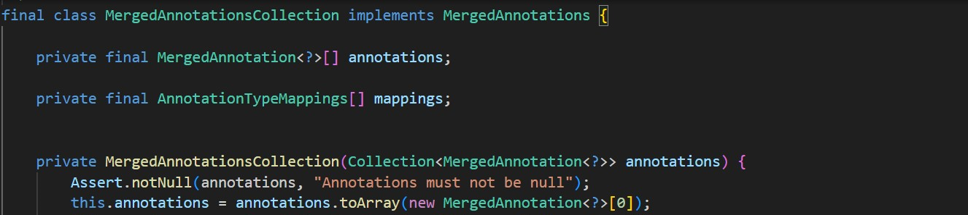
Dependency Injection in Spring Framework
The following code in Spring Framework (spring-framework-main/spring-core/src/main/java/org/springframework/core/annotation/MergedAnnotationsCollection.java)
uses constructor injection to receive annotations as arguments of the constructor and set it as its attribute.

Slide 9
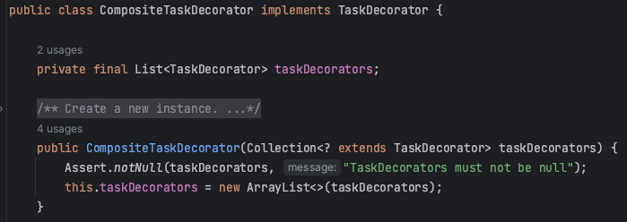
Dependency Injection in Spring Framework
When using constructor injection, it's common to mark the dependency as final to ensure that it cannot be reassigned after the constructor is called. This promotes good DI practices and enhances the overall robustness and maintainability of the code.

Slide 10
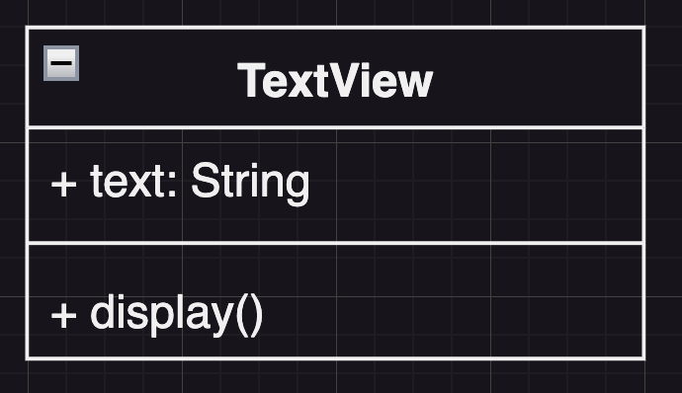
HW1. File Viewer (Initial Design)
We have a TextView object that displays text in a window.

Slide 11
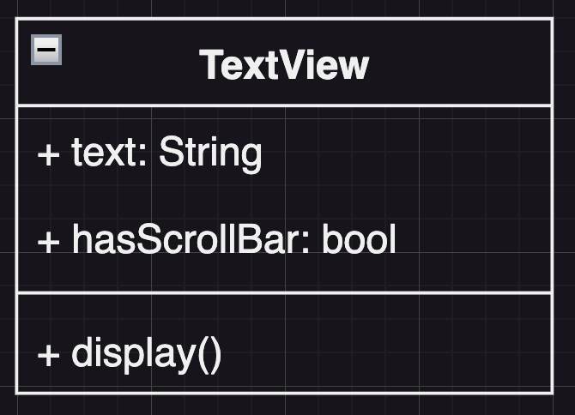
HW1. File Viewer (Initial Design)
TextView has no scroll bars by default, because we might not always need them.

Slide 12
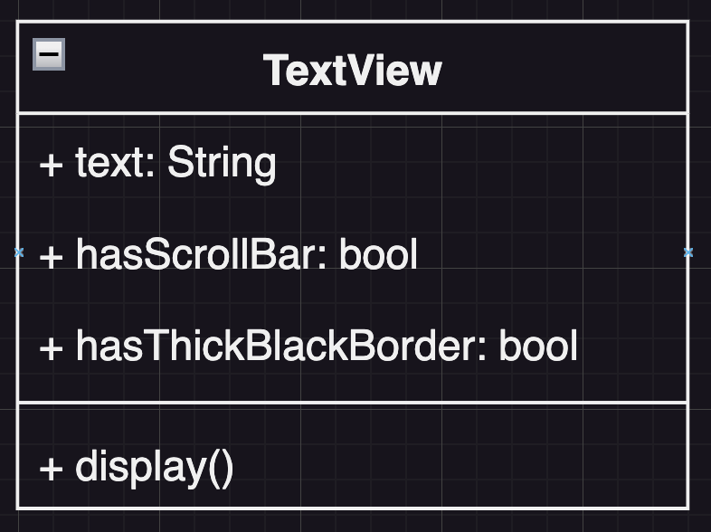
HW1. File Viewer (Initial Design)
We can also add a thick black border around the TextView.

Slide 13
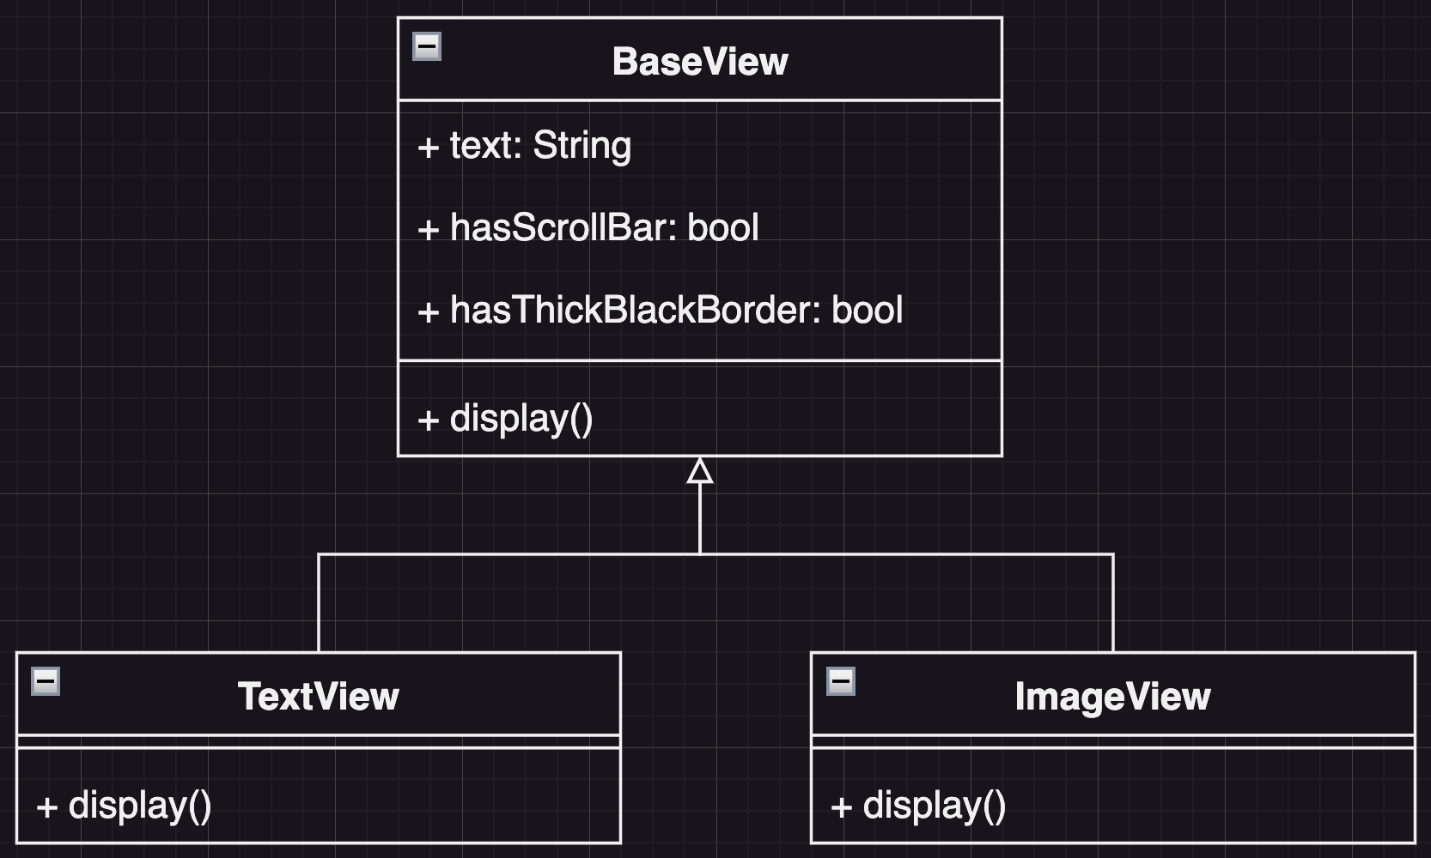
HW1. File Viewer (Initial Design)
It is highly likely that we will support various file formats for display in the future.

Slide 14
HW1. File Viewer (Refactored Design)
Both the Scroll Bar and the Thick Black Border are elements of the Viewer. In the future, there may be a need to expand with many different elements, so using flags cannot satisfy the Open-Closed Principle (OCP).
One approach is to abstract the elements and use a list to place them in the View class. Another approach is to adopt the Decorator Pattern.
We chose the Decorator Pattern because it allows for a better separation of the relationship between View and Element while maintaining the extensibility of View (supporting various file formats) and the extensibility of Element.

Slide 15
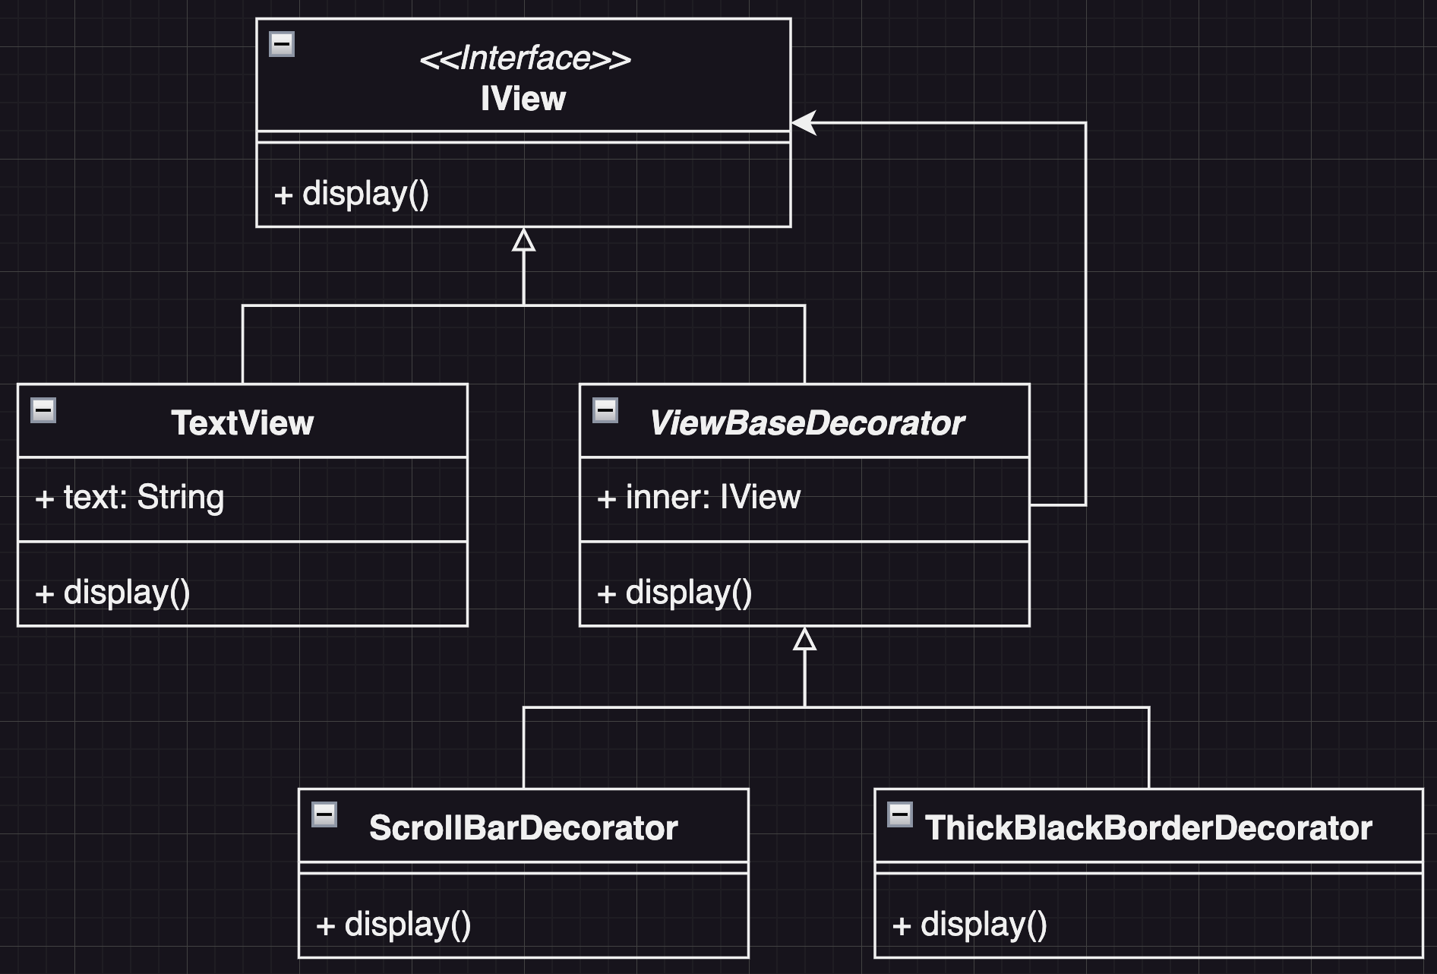
HW1. File Viewer (Refactored Design)

Slide 16
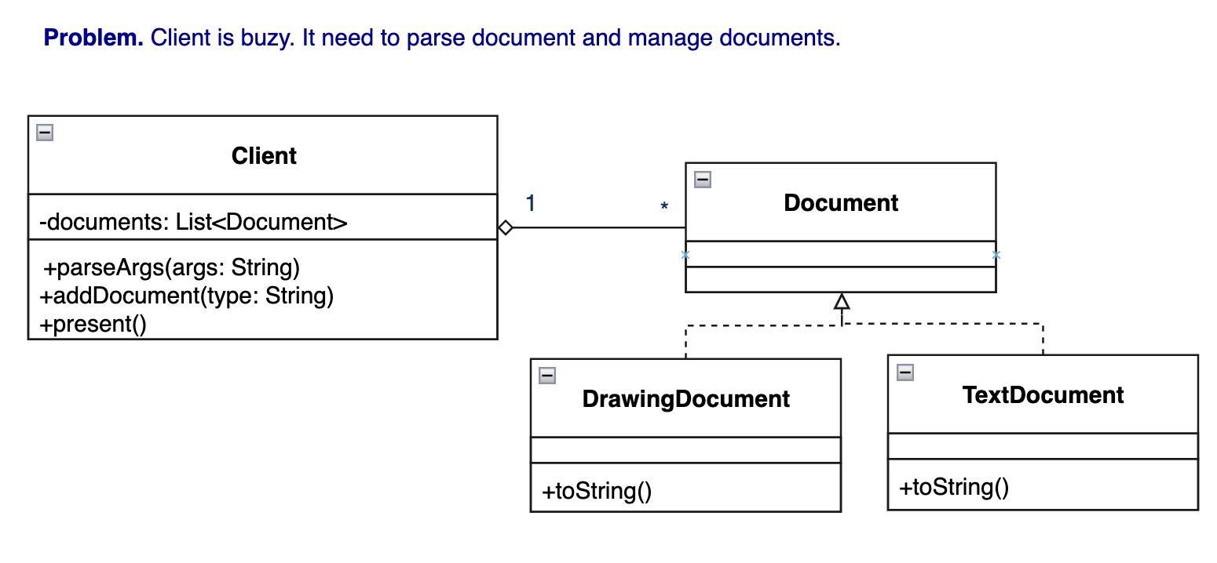
HW2. Powerful Document Viewer (Initial Design)
Problem: Client is buzy. It need to parse document and manage documents.
Act: Delegate document manage jobs to Controller (next page).
A powerful application can present multiple documents at the same time.
These documents include DrawingDocument, TextDocument, and so on.
The application is responsible for managing documents and creating them as required.
Notes:
Factory Pattern?

Slide 17
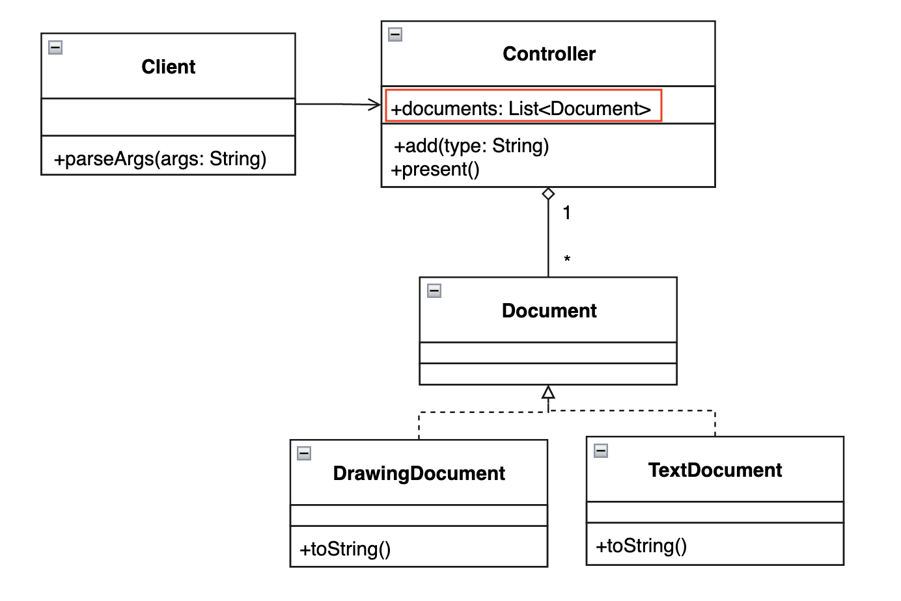
HW2. Powerful Document Viewer (Refactored Design)
Use a Controller to manage the created Document.
The Controller can decide how to present/store the documents (e.g., List<Document>) .

Slide 18
Code Tracing

Slide 19
Weekly Code Tracing Progress
 | Part | LOC
spring-core-core
許庭瑋 | TouchableDataBuffer.java,CloseableDataBuffer.java, PooledDataBuffer.java,DataBufferWrapper.java, NettyDataBuffer.java | 509
楊昕叡 | AnnotationTypeMappings.java, MergedAnnotationsCollection.java, MissingMergedAnnotation.java | 493
劉玠均 | ResolvableType.java (1/2), ResolvableTypeProvider.java | 508
洪世彬 | org.springframework.core.metrics, org.springframework.core.style | 557
spring-core-aot, spring-core-cglib
陳君翰 | org.springframework.aot.hint.predicate, org.springframework.aot.hint.annotation | 553
林俊佑 | core.ClassEmitter + core.CodeEmitter | 873

Slide 20
許庭瑋
TouchableDataBuffer
interface
touch(): associate the given hint with the data buffer for debugging purposes.
CloseableDataBuffer
interface, extends DataBuffer
close(): close the buffer
PooledDataBuffer
interface, extends TouchableDataBuffer
allows for buffers that share a memory pool, provide related functions like isAllocated, retain, touch, release
Notes:
ConvertingComparator<S, T>, DefaultConversionService, 8 default converters

Slide 21
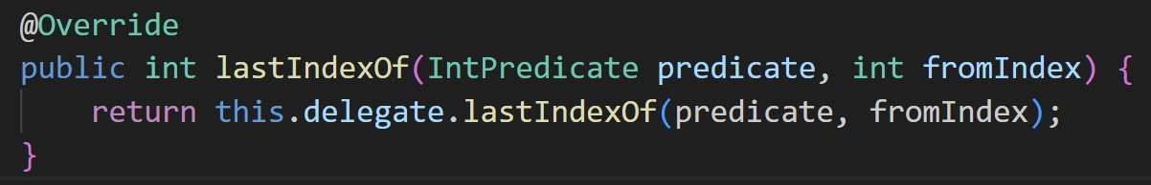
許庭瑋
DataBufferWrapper
very simple implementation of DataBuffer to delegate
all of the functions are delegate to DataBuffer functions
like this ->
NettyDataBuffer
implementation of PooledDataBuffer
use netty 4 ByteBuf instead of ByteBuffer
indexOf: use ByteBuf.forEachByte to get index
Notes:
ConvertingComparator<S, T>, DefaultConversionService, 8 default converters

Slide 22
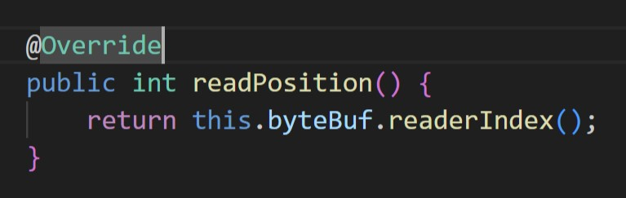
許庭瑋
NettyDataBuffer
lastIndexOf: use ByteBuf.forEachByteDesc to check byte in descending order
ByteBuf provide many useful functions which can implement what Spring want. Many functions in NettyDataBuffer are simply implement by calling functions in ByteBuf.
like this->
Notes:
ConvertingComparator<S, T>, DefaultConversionService, 8 default converters

Slide 23
許庭瑋
NettyDataBuffer
write(DataBuffer... dataBuffers): check if there is at least one NettyDataBuffer in the array. if true, change type of all elements in dataBuffers to NettyDataBuffer, and use ByteBuf.writeBytes to write datas.
split(int index): use ByteBuf.retainedSlice and ByteBuf.slice to cut buffer, and calculate readerIndex and writerIndex.
ByteBufferIterator: an inner class, use for iterating an array of ByteBuffer.
Notes:
ConvertingComparator<S, T>, DefaultConversionService, 8 default converters

Slide 24
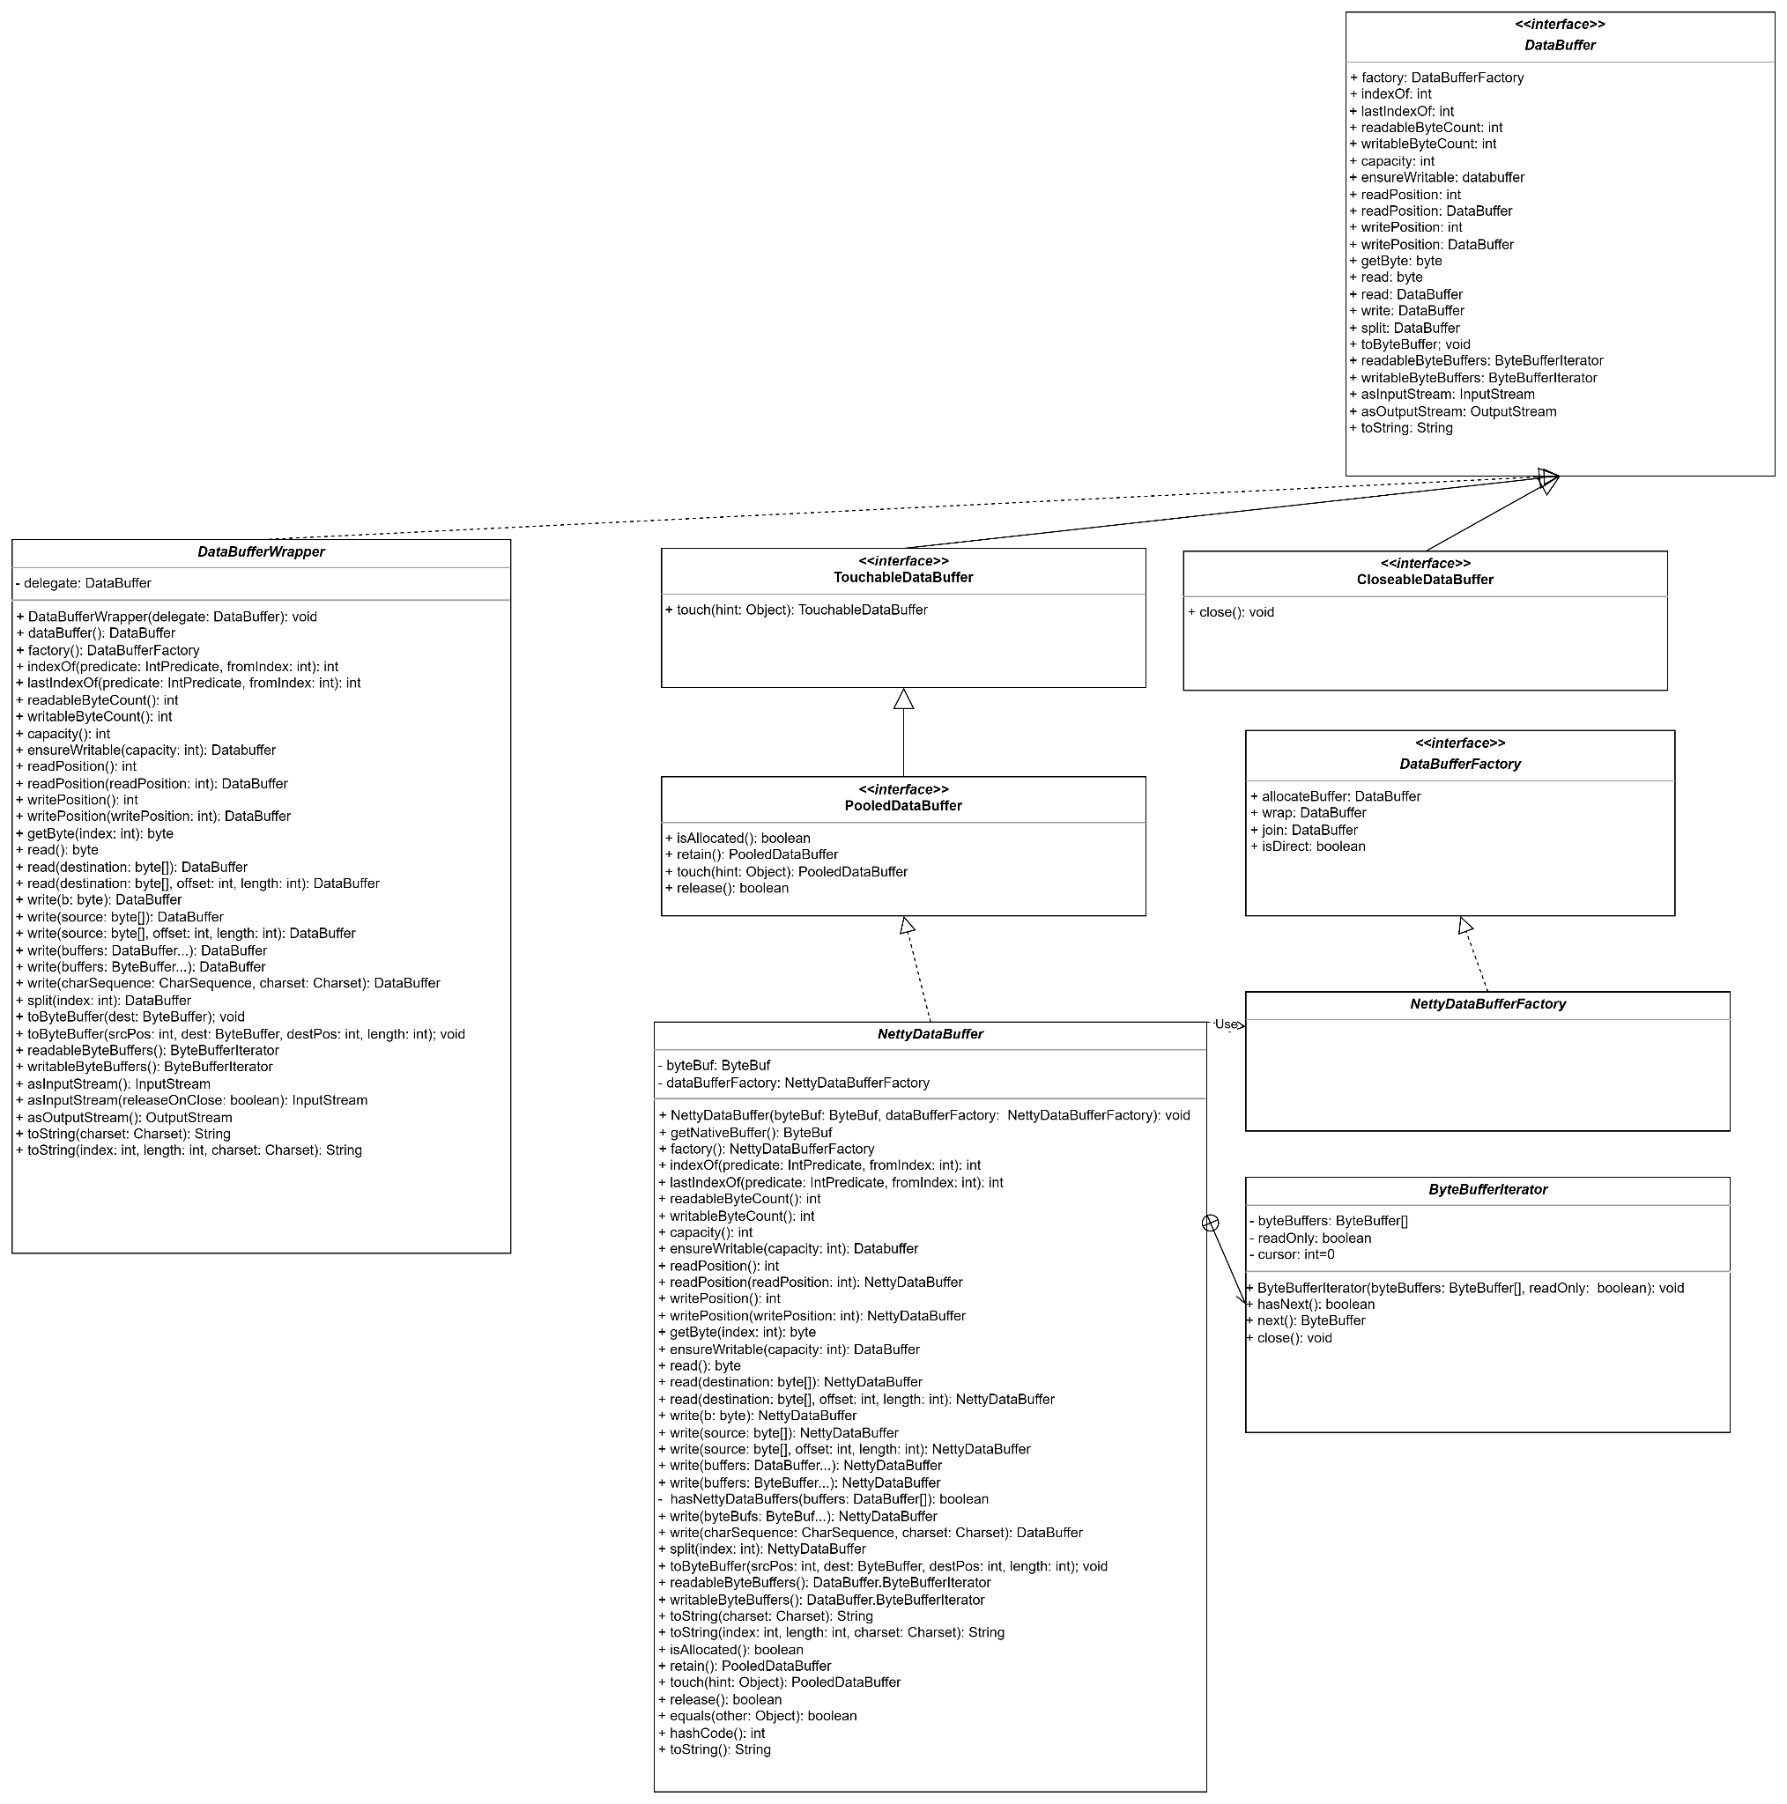
許庭瑋
class diagram for this week
files related to databuffer,
extends last week.
Notes:
ConvertingComparator<S, T>, DefaultConversionService, 8 default converters

Slide 25
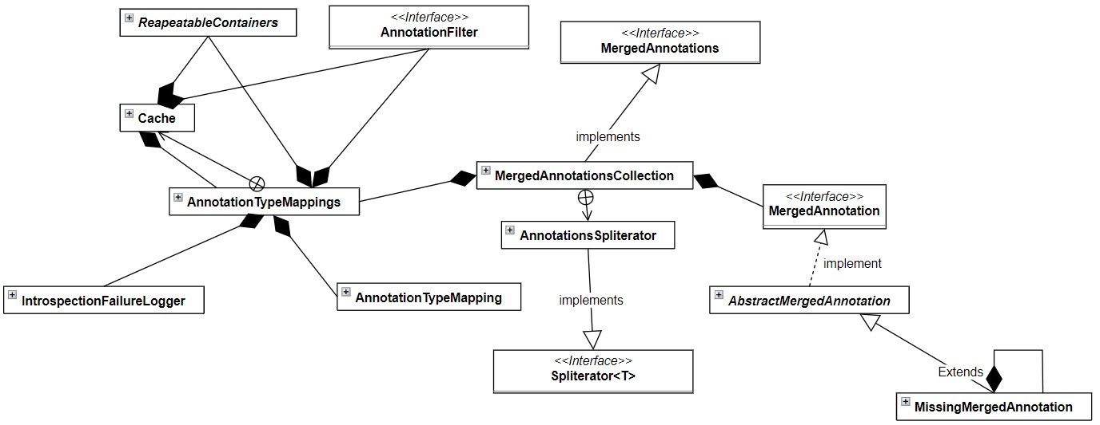
楊昕叡
Class diagram: full version
Notes:
ConvertingComparator<S, T>, DefaultConversionService, 8 default converters

Slide 26
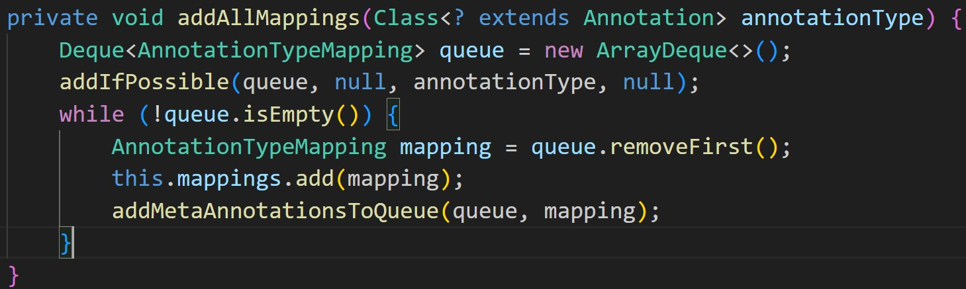
楊昕叡
final class AnnotationTypeMappings
addAllMappings() uses breadth first search to find all mappings (meta-annotations) a given annotation type.
Notes:
ConvertingComparator<S, T>, DefaultConversionService, 8 default converters

Slide 27
楊昕叡
final class AnnotationTypeMappings
static AnnotationTypeMappings forAnnotationType(Class<? extends Annotation> annotationType, RepeatableContainers repeatableContainers, AnnotationFilter annotationFilter)
This method create AnnotationTypeMappings for a given annotation type (with help of maps (filter->mappings) and innerclass Cache(type->mappings)).
Flow: For a filter, if it’s in maps, get it (a same filter always sweep out same mappings), otherwise use Cache to get mappings for a type and add <filter, mappings> to maps.
Notes:
ConvertingComparator<S, T>, DefaultConversionService, 8 default converters

Slide 28
楊昕叡
final class AnnotationTypeMappings
static AnnotationTypeMappings forAnnotationType(Class<? extends Annotation> annotationType, RepeatableContainers repeatableContainers, AnnotationFilter annotationFilter)
As the unique public method, outer classes can only create AnnotationTypeMappings from here.
Notes:
ConvertingComparator<S, T>, DefaultConversionService, 8 default converters

Slide 29
楊昕叡
final class MergedAnnotationsCollection implements MergedAnnotations
private <A extends Annotation> MergedAnnotation<A> find(Object requiredType, @Nullable Predicate<? super MergedAnnotation<A>> predicate, @Nullable MergedAnnotationSelector<A> selector)
From annotations of MergedAnnotationsCollection, find the best annotation selected by selcetor (e.g. nearest distance in annotation hierachy) with required type.
Notes:
ConvertingComparator<S, T>, DefaultConversionService, 8 default converters

Slide 30
楊昕叡
final class MergedAnnotationsCollection implements MergedAnnotations
private class AnnotationsSpliterator<A extends Annotation> implements Spliterator<MergedAnnotation<A>>
Implement tryAdvance(): From annotations in MergedAnnotationsCollection, find their mappings, determine if it is possible to create MergedAnnotation from a mapping with required type and unselected before, and annotation with lowest distance are selected first. The spliterator is used in iterator(), spliterator(), stream() in MergedAnnotationsCollection.
Notes:
ConvertingComparator<S, T>, DefaultConversionService, 8 default converters

Slide 31
楊昕叡
final class MergedAnnotationsCollection implements MergedAnnotations
private class AnnotationsSpliterator<A extends Annotation> implements Spliterator<MergedAnnotation<A>>
This inner class and the AggregatesSpliterator in W7 both implements spliterator interface, so the use of spliterator satisfy DIP.
Notes:
ConvertingComparator<S, T>, DefaultConversionService, 8 default converters

Slide 32
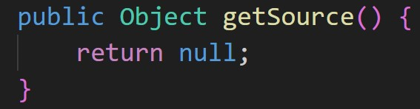
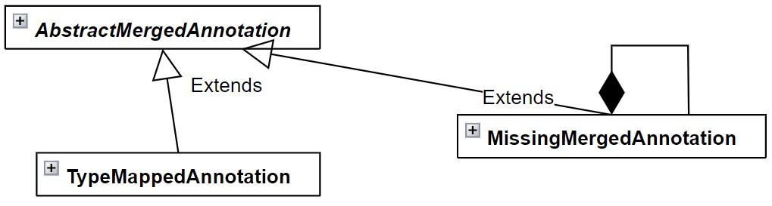
楊昕叡
final class MissingMergedAnnotation<A extends Annotation> extends AbstractMergedAnnotation<A>
Use Null Object Pattern to implement a missing annotation, and all methods returning this annotation’s information(getsource(), getDistance()...) all return null, -1, throw exception to indicate “Null”.
(TypeMappedAnnotation acts as Real Object)
Also, this class is the composition of itself.
Notes:
ConvertingComparator<S, T>, DefaultConversionService, 8 default converters

Slide 33
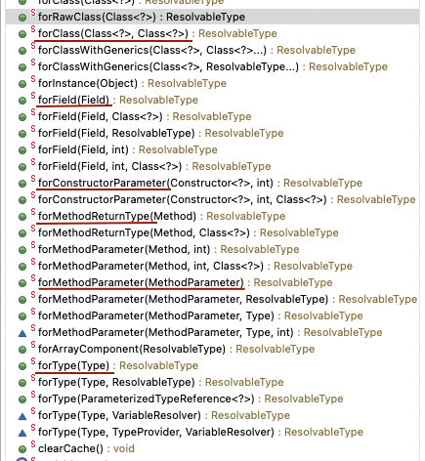
劉玠均 (ResolvableType)
ResolvableType is a class that encapsulates common operations (e.g., getGenerics) of java.lang.reflect.Type.
The supported types (e.g., for*(...)) are:
Class, Field, Constructor<?>
Type, Method, MethodParameter
, they are converted to ResolvableType.
Notes:
ConvertingComparator<S, T>, DefaultConversionService, 8 default converters

Slide 34
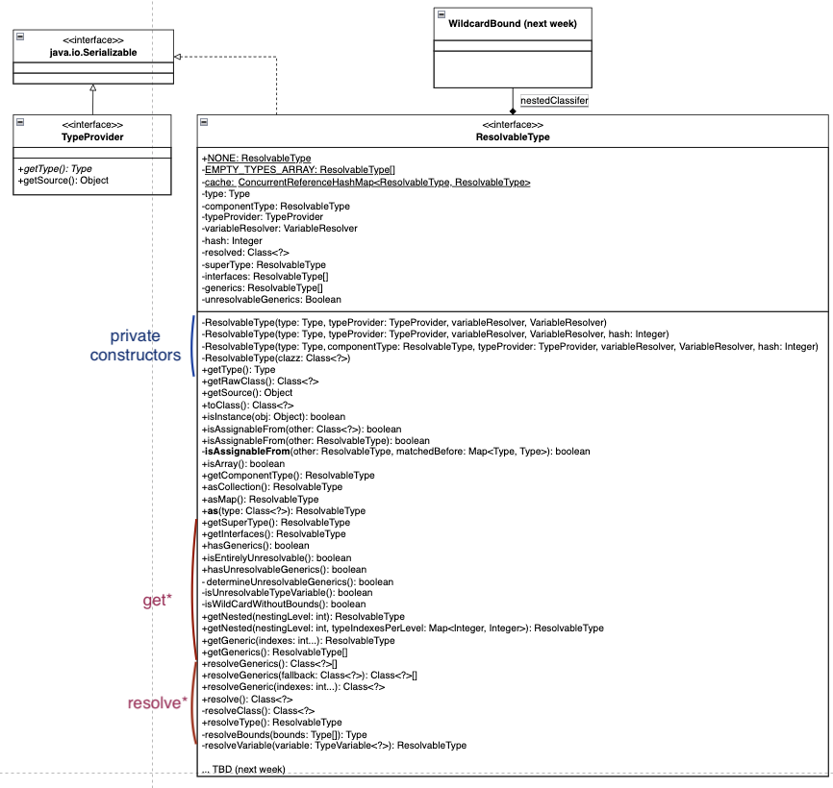
劉玠均 (ResolvableType)
Code reading breakdown
W8 (this week): encapsulated functions (e.g., getGeneric(), resolveGenerics())
W9: for* (e.g., forClass()) functions
Class diagram (right fig.)
Notes:
ConvertingComparator<S, T>, DefaultConversionService, 8 default converters

Slide 35
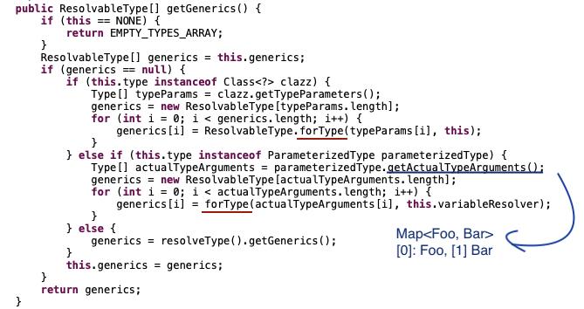
Highlights (ResolvableType)
Only contains private constructors: the access points are for* functions such as forClass().
Deal with the operations of the subinterfaces of Type: GenericArrayType, ParameterizedType, TypeVariable<D>, WildcardType
Example: getGenerics()
ParameterizedType: Map<K,V>, List<? extends Number>
Check this.type by case. For a ParameterizedType, it create a ResolvableType for each actual type parameters.

Slide 36
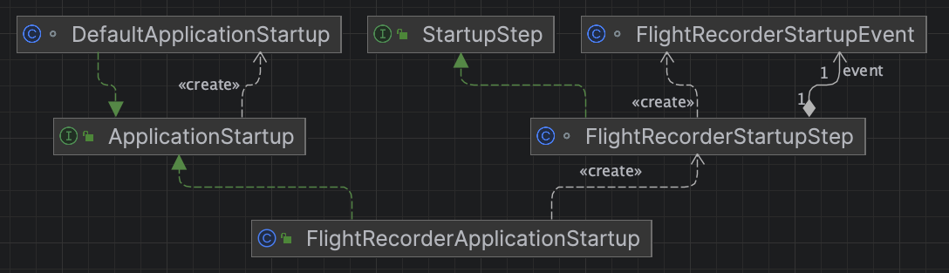
洪世彬
ApplicationStartup is used to mark steps during the application startup and collect data about the execution context or their processing time. And the StartupStep recording metrics about a particular phase or action happening during the ApplicationStartup.

Slide 37
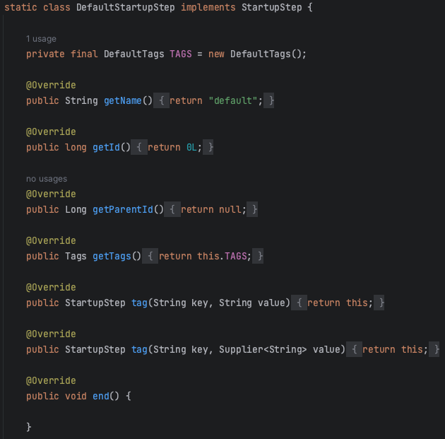
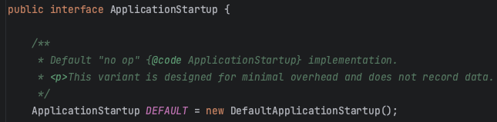
洪世彬
ApplicationStartup uses the Null Object Pattern to provide a default behavior, DefaultApplicationStartup. The default behavior provides a default object, DefaultStartupStep.
If users have specific requirements, they can inherit from ApplicationStartup and StartupStep to implement specific functionality.

Slide 38
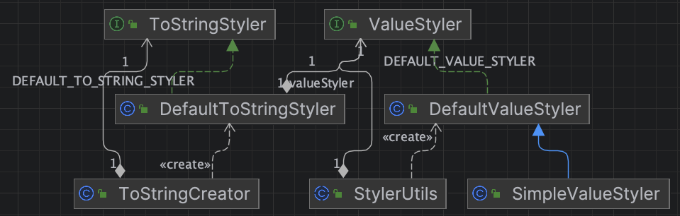
洪世彬
ToStringStyler is a strategy interface for pretty-printing toString() methods. It allows users to convert any object into a String representation.

Slide 39
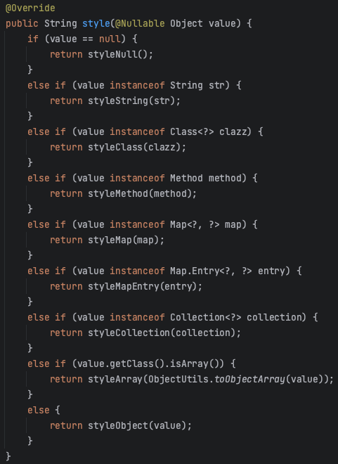
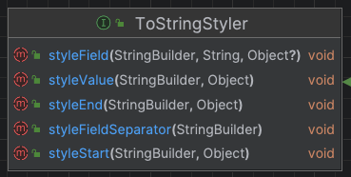
洪世彬
ValueStyler encapsulates value String styling algorithms. It defines a style function for members to convert objects to strings. DefaultValueStyler implements text conversion methods for various data types.

Slide 40
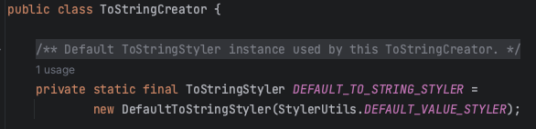
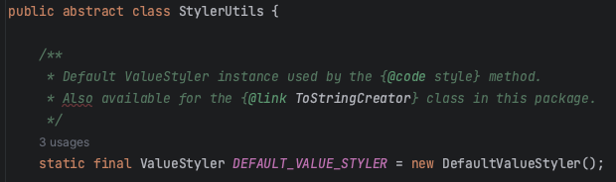
洪世彬
ToStringCreator also uses Null Object Pattern and injects a set of default conversion methods.

Slide 41
陳君翰 - predicate
基礎概念
概念：一個用來檢測真假（回傳 true false）的 expression
例如：isCharacter() 可以用來檢測是否為字元
Java Predicate Interface
public interface Predicate<T>
他是一個 functional interface，所以可以接收 lambda expression
他的 functional method 是 test(Object) ，可以用它來啟動
範例如下
Predicate<Integer> isZero = i -> {return i == 0;};
System.out.println(isZero.test(0)); // true
System.out.println(isZero.test(100)); // false

Slide 42
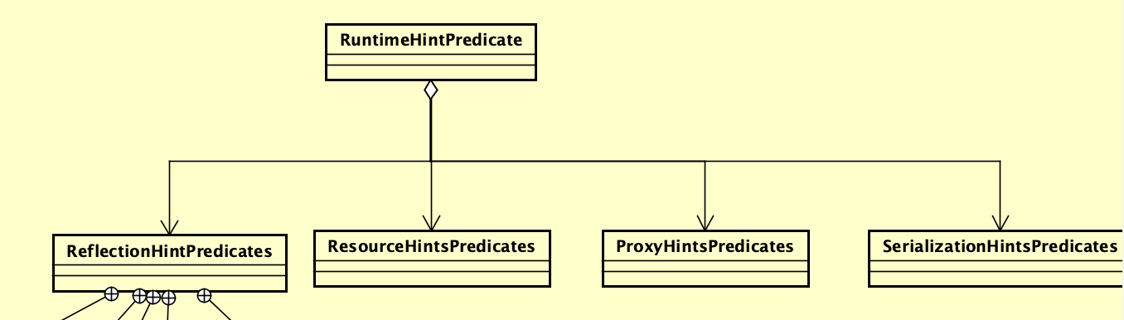
陳君翰 - runtime hint predicate
內容大同小異，都是丟入某個內容進來，調閱現有的 runtime hint，確認該內容是否已經存在於 runtime hint 中
比較重要的應該是要回憶 runtime hint 中的各種細節

Slide 43
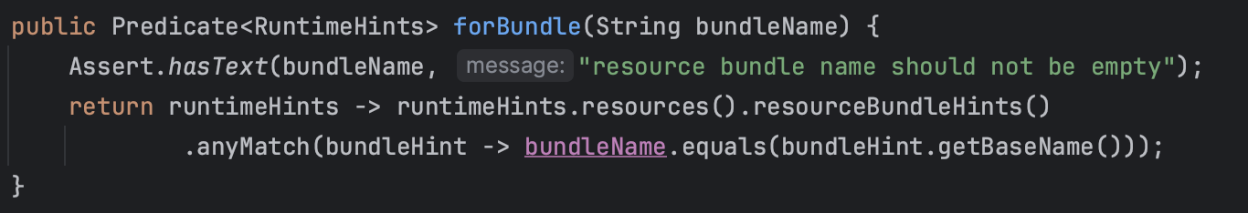
陳君翰 - resource, proxy, serialization hint predicate
丟入比較的對象，函式會回傳 predicate，此 predicate 可以被用來檢測 hint 是否有符合行為要求
predicate 內部流程：從 runtime hints 中取出相關內容 -> 轉為 Stream -> 依序比對各個 hint 和比較對象，
以下圖 resource hint predicate 的 forBundle 為例

Slide 44
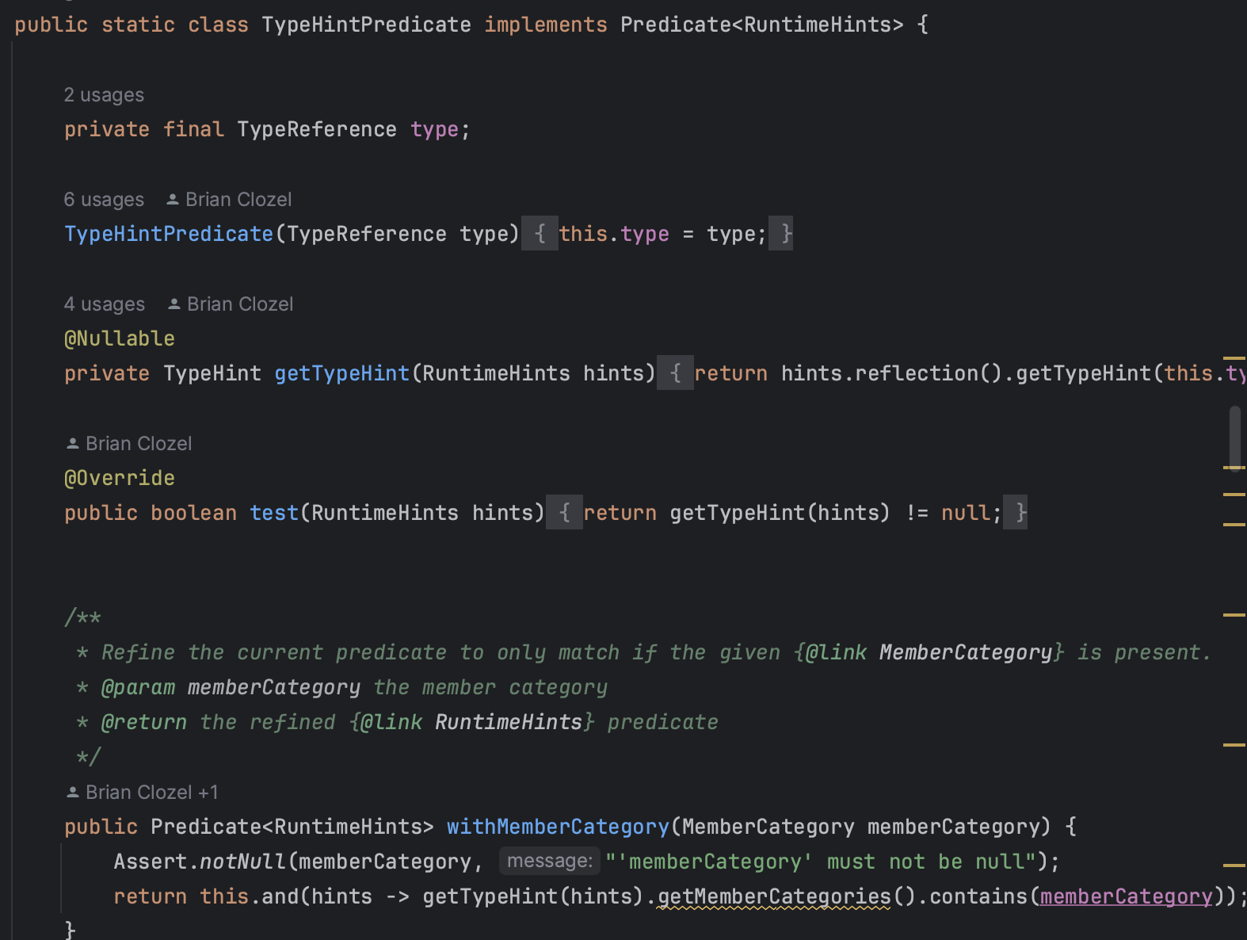
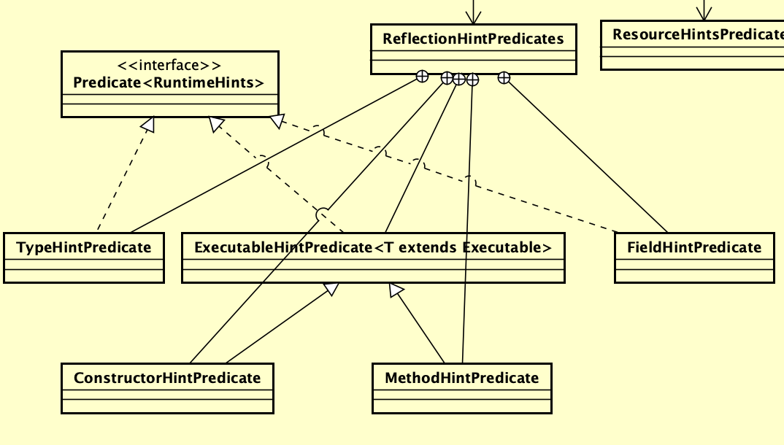
陳君翰 - reflection hint predicate
由於 reflection 本身就是有 type, field, constructor, method 四個面向要處理，所以他也跟著拆分各自做 predicate
但實作內容實際與前述差異不大，但尚且不確定實作 predicate interface，取代掉 test() 的目的性

Slide 45
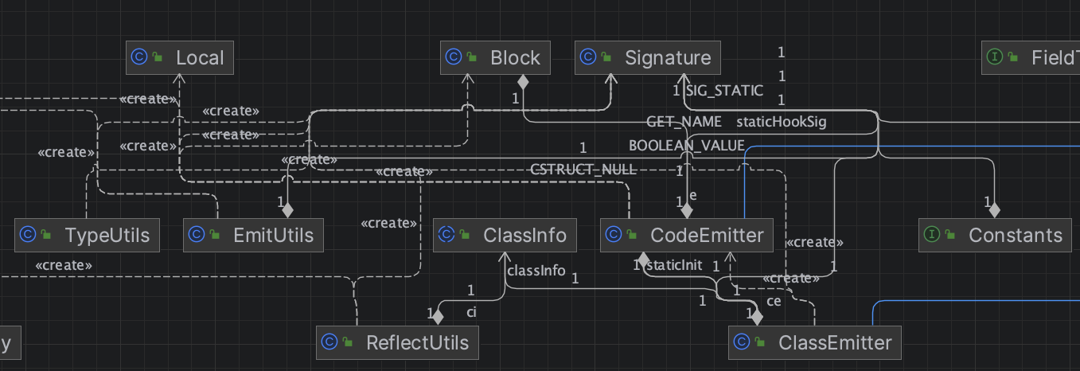
林俊佑 - Class Emitter
由上一塊可以得知, emitter 是協助 generateClass 生成 bin 的核心工具
這週來好好看看其相關模塊

Slide 46
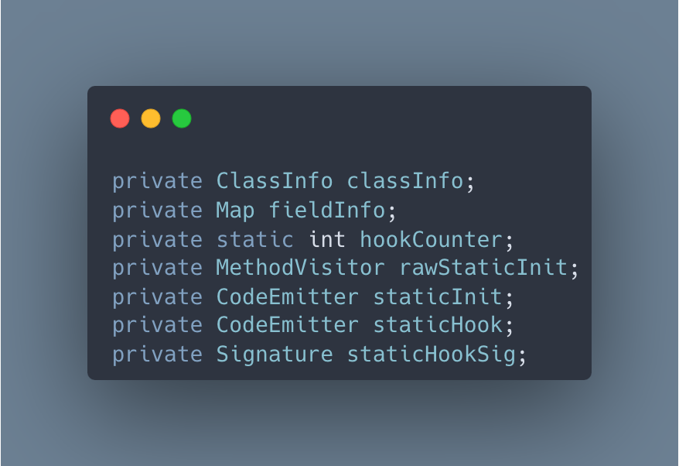
透過宣告得知 classEmitter 有哪些 relation

Slide 47
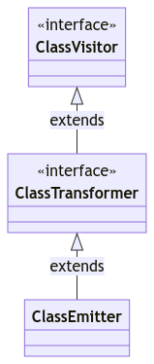
至此要先理清 classEmitter 的繼承關係
其中
ClassVisitor 主要定義介面與介面調用方法
ClassTransformer 延伸了 setTarget 的方法
ClassEmitter 提供介面寫入 class 內容成為 binary 物件, 可以用此創建客製化 class (含想要的 callback)

Slide 48
接著開始詳細了解整個 Class Emitter 的調用吧
內容太多, 完整內容放在: https://leon1234858.notion.site/week8-presen-015d17207b1042dd9497c8a4e4827e1a?pvs=4
以下投影片簡述幾樣有趣之處

Slide 49
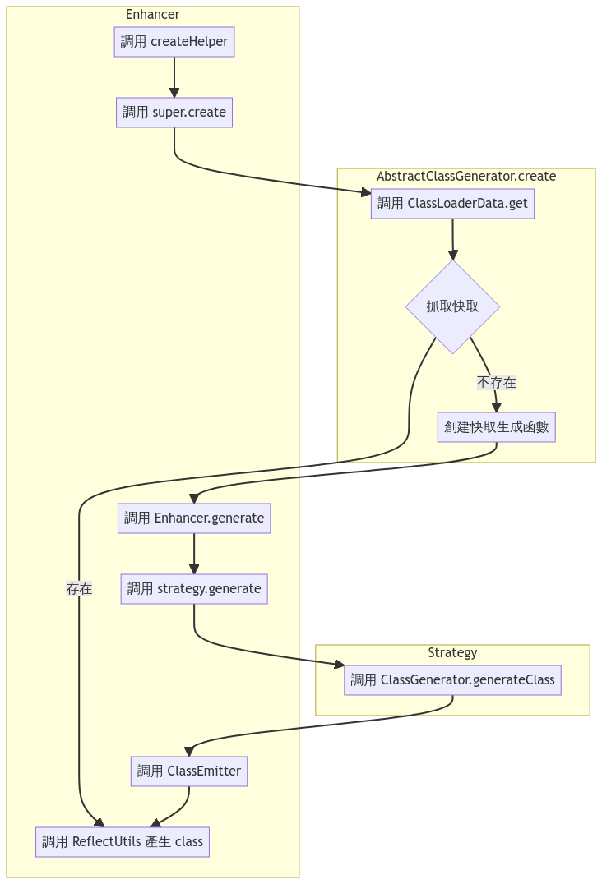
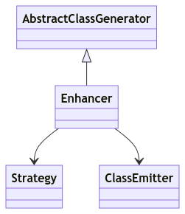
感想:
核心邏輯放實作 ex: Enhancer
實作會透過調用父類別使用通用邏輯
實作會透過委派使用外部工具
外部工具遇到和實作相關邏輯時又會調用回實作本身的函數(外部工具委派回實作, 實作和外部工具互相委派) ⇒ 標準”策略模式”

Slide 50
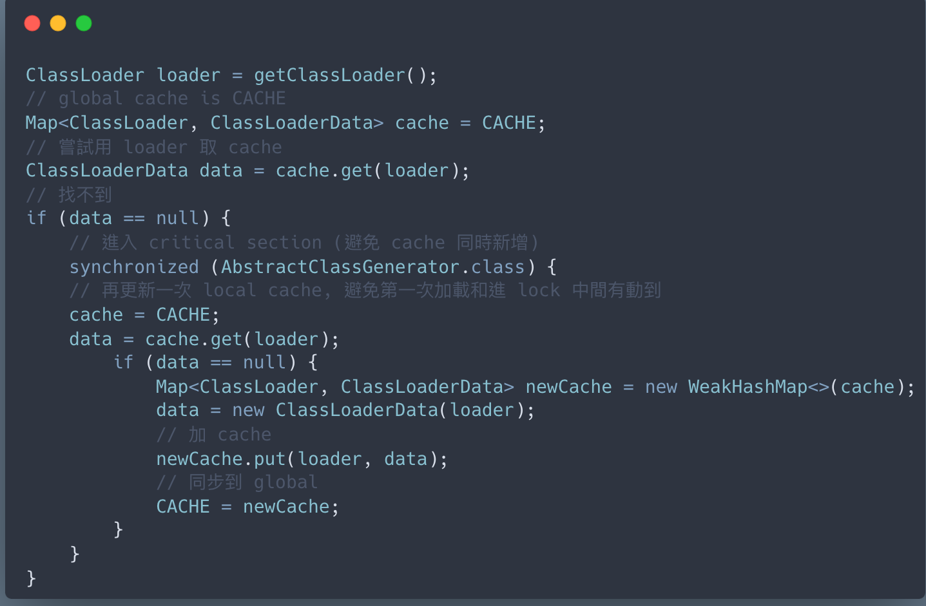
實作 cache 的方法: static + volatile + weakReference
static volatile Map<ClassLoader, ClassLoaderData> CACHE = new WeakHashMap<>();

